Slide 1
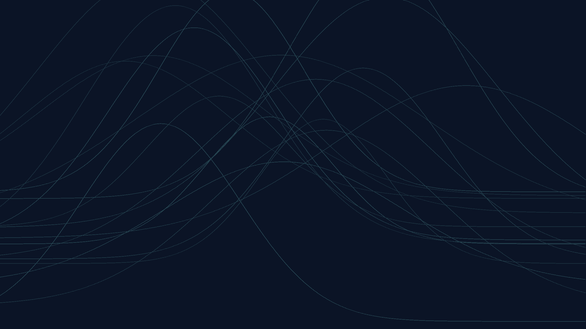


travo
TRAVO
TRAVO
TRAVO · TOTAL RISK ANALYSIS & VALUE OPTIMIZATION
Service Catalogue
& Methodology
MAY 2026 · v.1.0

Slide 2
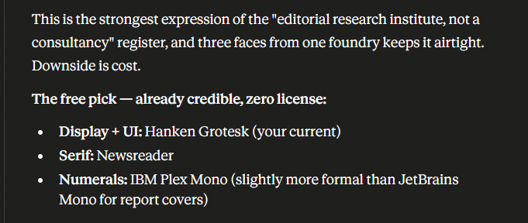
TRAVO · TOTAL RISK ANALYSIS & VALUE OPTIMIZATION
Service Catalogue
& Methodology
MAY 2026 · v.1.0

Slide 3
TRAVO · TOTAL RISK ANALYSIS & VALUE OPTIMIZATION
Service Catalogue
& Methodology
MAY 2026 · v.1.0

Slide 4
TRAVO · TOTAL RISK ANALYSIS & VALUE OPTIMIZATION
Service Catalogue
& Methodology
MAY 2026 · v.1.0

Slide 5
TRAVO · TOTAL RISK ANALYSIS & VALUE OPTIMIZATION
123456789
MAY 2026 · v.1.0

Slide 6
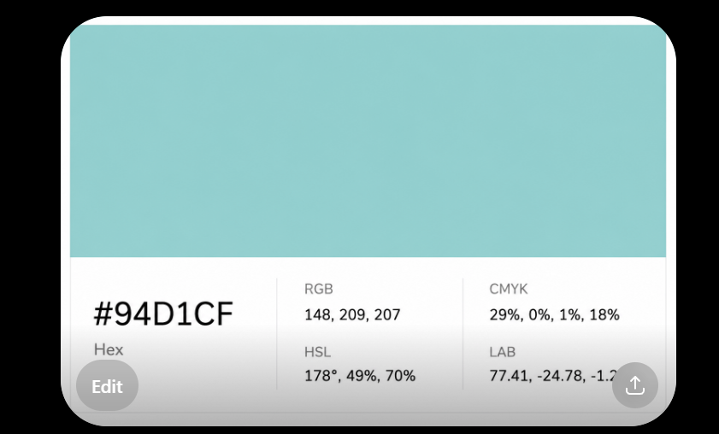
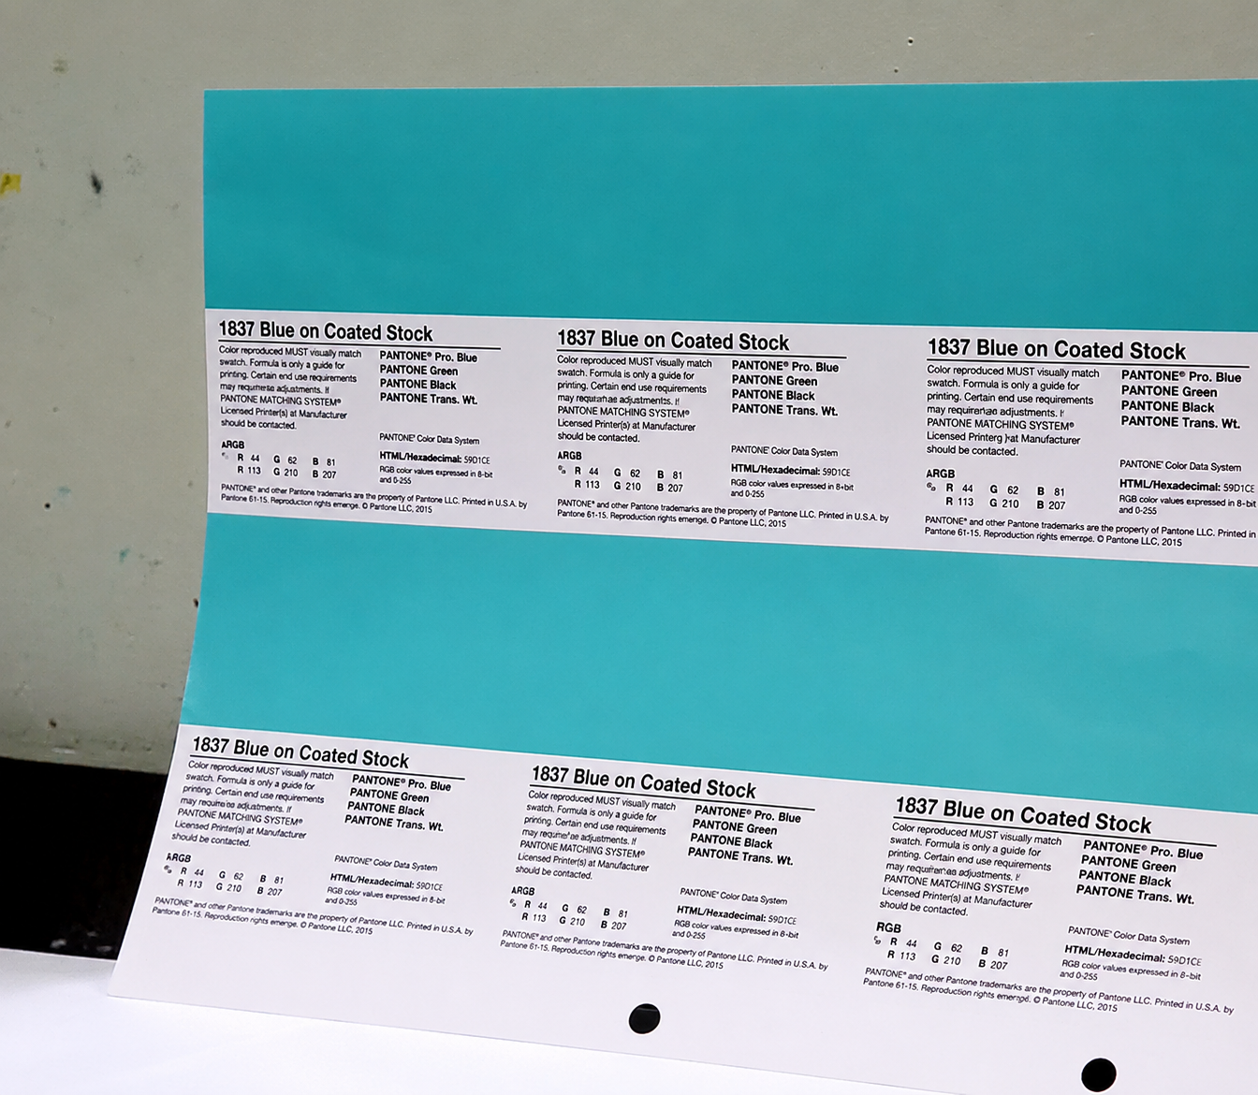
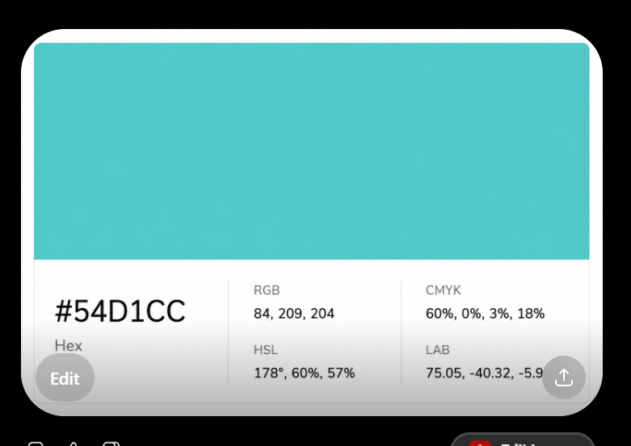
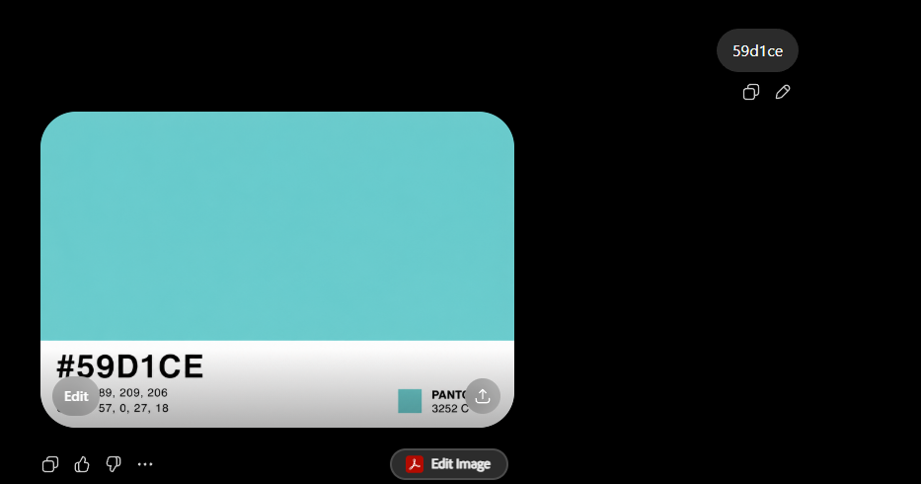
44
82
81
Final Palette
24
84
83
255
91
94
255
185
187
197
236
254
113
210
207
44
82
81
147
164
179
44
45
82
30
30
46
89
209
206
44
62
81
84
209
204
Travo teal

Slide 7
Final Palette
255
91
94
255
185
187
197
236
254
89
209
206
24
84
83
44
45
82
30
30
46
Travo teal
147
164
179

Slide 8
Final Palette
89
209
206
30
30
46
89
209
206
255
91
94
255
185
187
197
236
254
89
209
206
24
84
83
44
45
82
30
30
46
Deep navy blue: RGB (0, 37, 61) — Hex #00253D Tiffany teal: RGB (129, 216, 208) — Hex #81D8D0 Warm yellow: RGB (255, 199, 44) — Hex #FFC72C
Travo teal
147
164
179

Slide 10
89
209
206

Slide 11
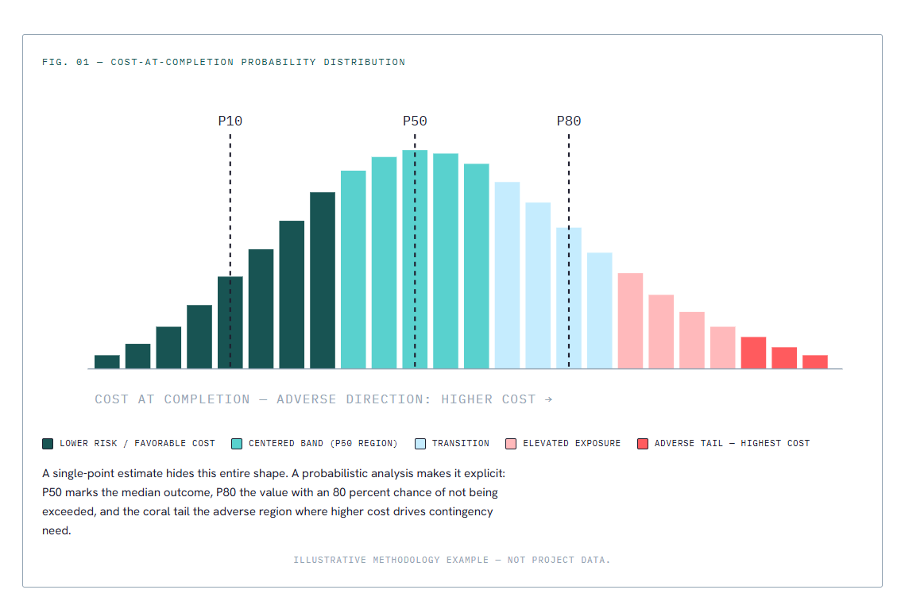

Slide 12
89
209
206
44
62
81

Slide 14
Inspiration
https://www.pentagram.com/work/gsa
TRAVO

Slide 15
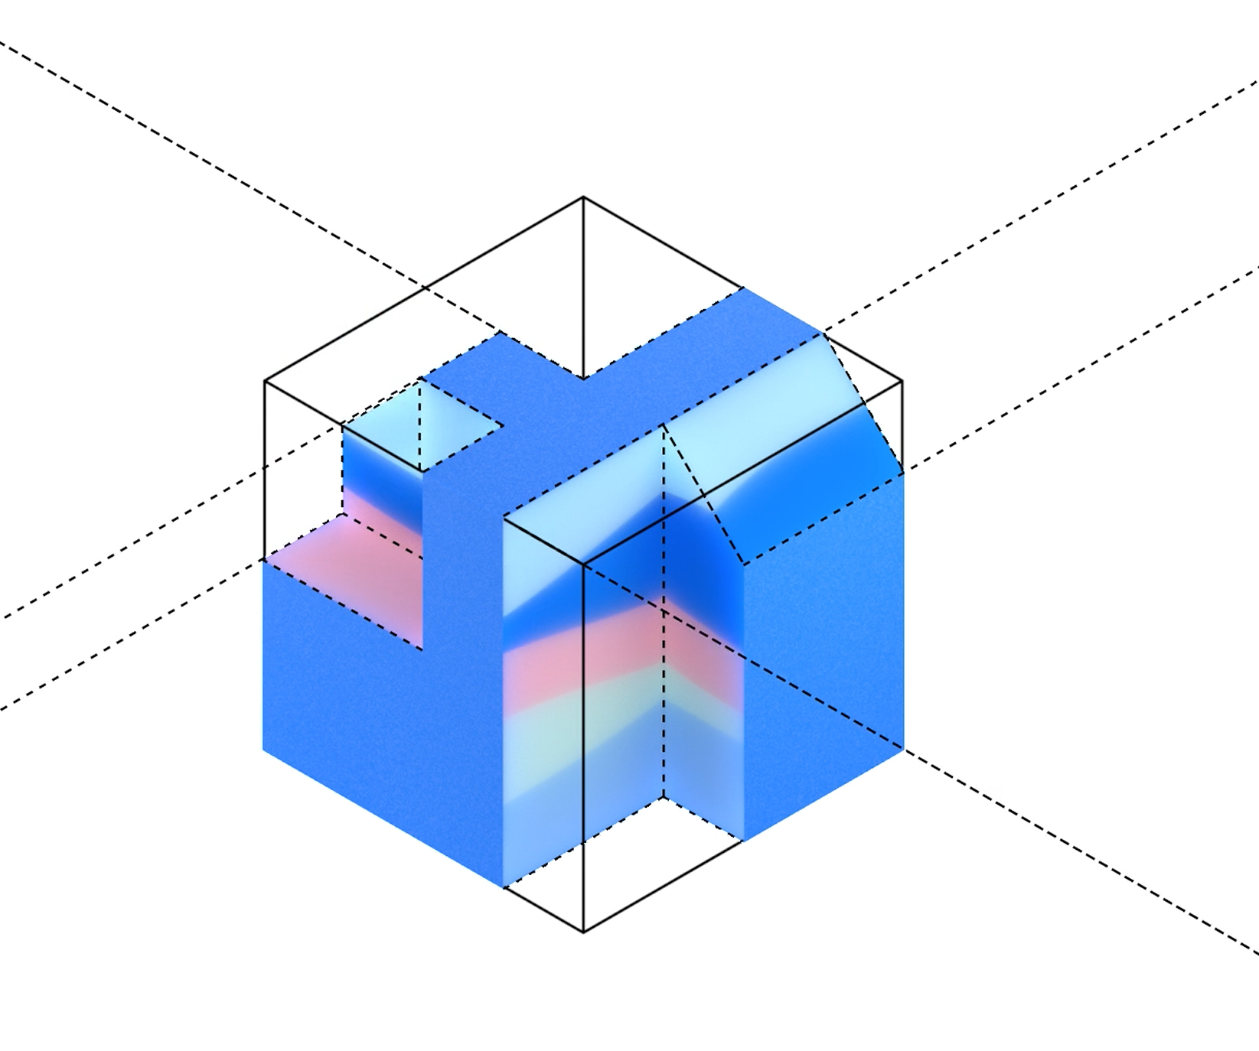


Slide 17
113
210
207
167, 186, 191
105, 172, 177

Slide 18



113
210
207
167, 186, 191
105, 172, 177

Slide 19
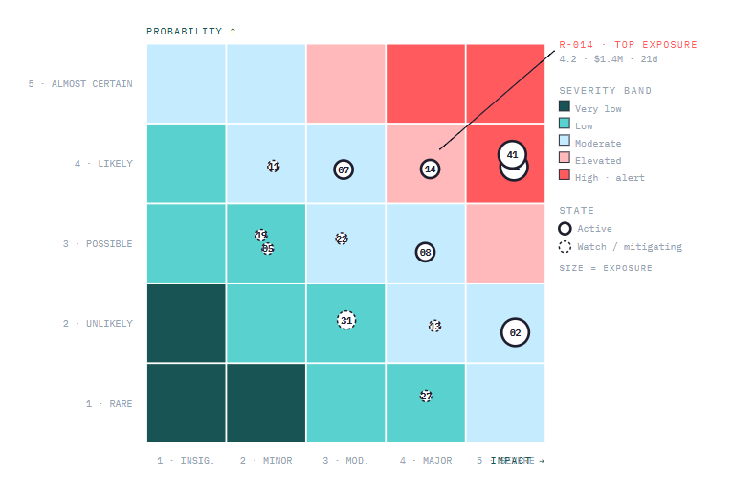

Slide 20


Slide 22


Slide 23
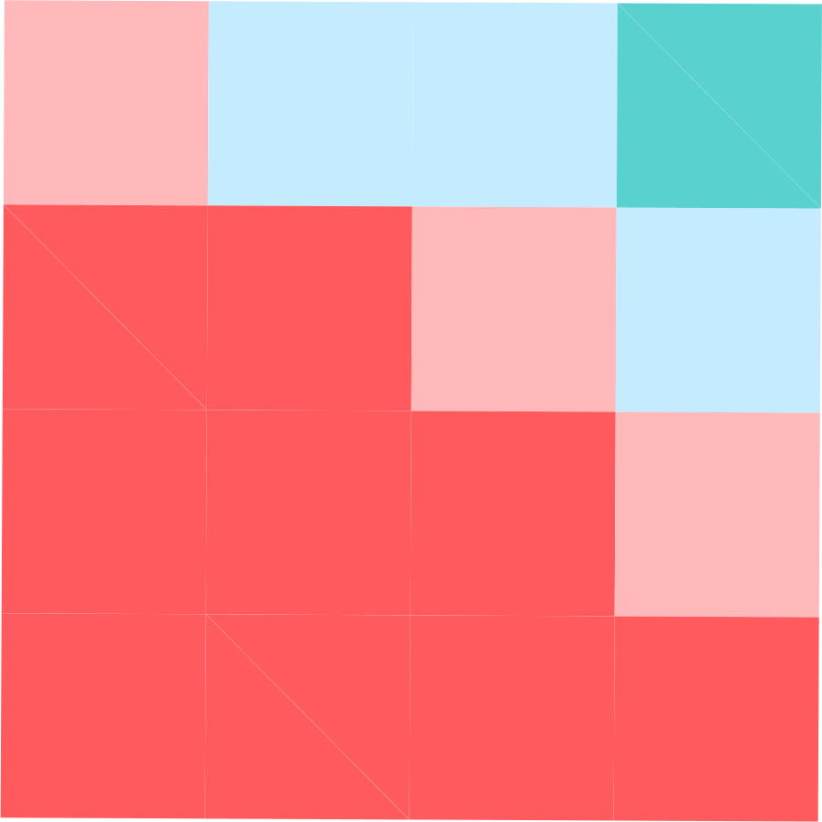

Slide 24


Slide 25


Slide 27
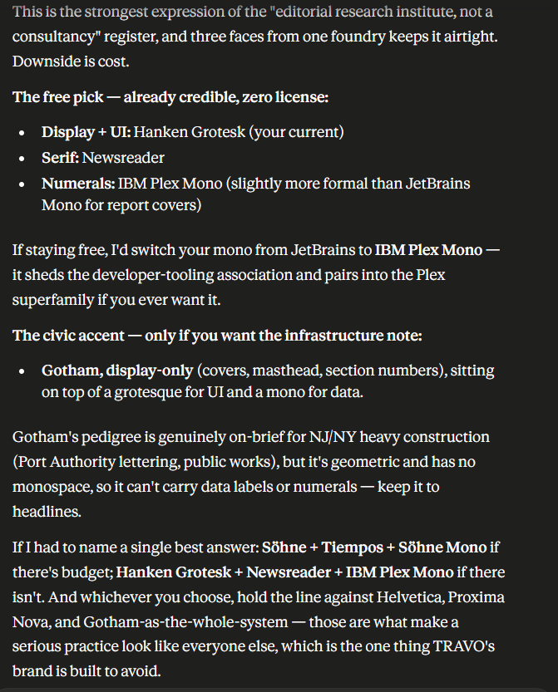

Slide 28

travo
travo.com
travo
Services
Methodology
Benchmarks
About
Contact
BRAND APPLICATION · 01
On the
SPECIALTY QUANTITATIVE RISK ADVISORY
The Standard for Construction
website
Risk Analysis in the NJ/NY Region.
Quantified Risk. · Defensible Decisions.
Independent, methodologically rigorous risk and contingency analysis for institutional owners, public agencies, and mid-sized contractors.
Request a consultation
The dark ground inverts the construction-services convention. The risk spectrum becomes a functional device — at the foot of the hero, color-coding each service card, signaling category at a glance.
WHAT WE DO · THE BOUNDED CATALOG
Nine services. Three categories.
A · PRE-PROJECT
B · DURING-PROJECT
C · POST-PROJECT
Quantitative risk analysis, contingency derivation, risk register, bid leveling, peer review.
Risk register retainer, trend-risk analysis, pre-claim and dispute readiness review.
Lessons-learned capture, portfolio benchmarking, methodology implementation.
TRAVO.COM · HOMEPAGE
4 services
3 services
3 services

Slide 29
CATALOG IN ACTION · REPRESENTATIVE OUTPUTS
How the risk spectrum reads in deliverables
BRAND APPLICATION · 02
On figures
Fig. 01 · The pattern travo exists to address
Industry benchmark · N≈10,000 capital projects
and graphs
70%
PROJECT OUTCOMES VS. BASELINE
8%
22%
28%
42%
OVERRUN BUDGET
UNDER
ON-BUDGET
OVER <30%
OVER ≥30%
The same five-stop spectrum that organizes the website organizes the data. Every chart the firm publishes uses the gradient as semantic encoding — verde for managed, coral for critical — so the visual language is consistent across marketing surfaces and methodology outputs.
≈30%
AVG SIZE OF OVERRUN
Fig. 02 · Active portfolio risk position · Service A1 output
Each bar's color encodes its position on the risk spectrum. Coral = critical. Verde = managed.
Hoboken Pier Restoration
-1%
Princeton Lab Fit-out
+4%
Trenton Courts
+9%
Stevens Lab Expansion
+12%
Liberty Medical Center
+19%
NJ/NY CONSTRUCTION RISK INDEX · 2026
Newark Air Terminal C
+24%
Hudson Tunnel Approach
+31%
Riverside Interchange 9
+38%

Slide 30
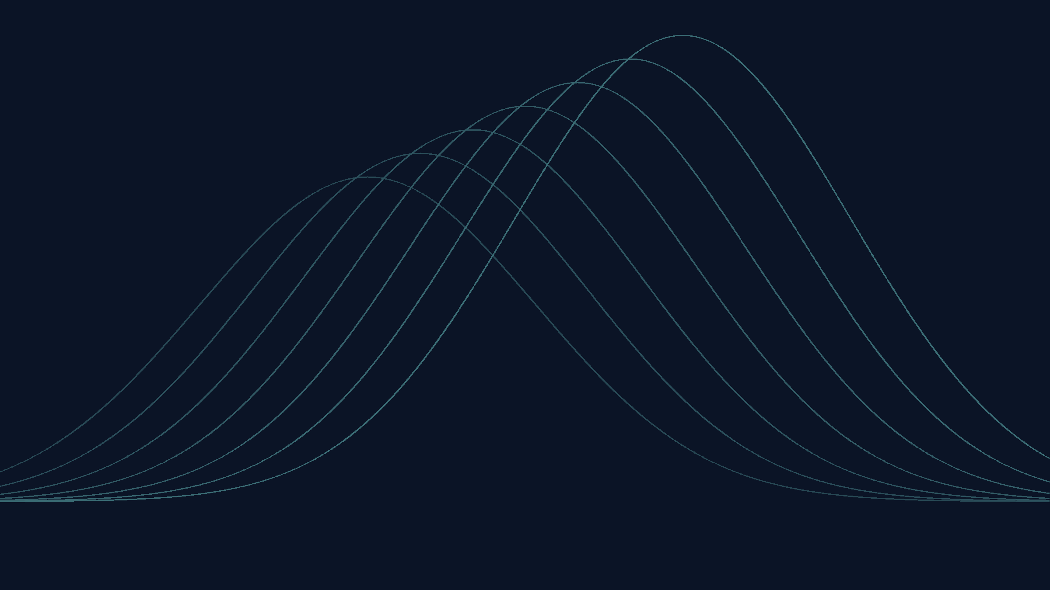
travo
CORE BELIEF
Most construction
project failures
are quantifiable
in advance.
70%
OF CAPITAL PROJECTS
OVERRUN BUDGET BY ≈30%

Slide 31
travo
CORE BELIEF
Most construction
project failures
are quantifiable
in advance.
70%
OF CAPITAL PROJECTS
OVERRUN BUDGET BY ≈30%

Slide 32
Final Palette
255
91
94
255
185
187
197
236
254
113
210
207
44
82
81
147
164
179
44
45
82
30
30
46

Slide 33
Dark Teal → Coral Alert
continuous palette gradient with exact RGB swatches
#2C5251
#FF5B5E

Slide 34

Continuous gradient
Five exact anchors at 0%, 25%, 50%, 75%, and 100%.
Dark Teal
Coral Alert
50%
#C5ECFE
RGB 197, 236, 254
75%
#FFB9BB
RGB 255, 185, 187
100%
#FF5B5E
RGB 255, 91, 94
255
91
94
255
185
187
197
236
254
89
209
206
24
84
83
0%
#2C5251
RGB 44, 82, 81
25%
#71D2CF
RGB 113, 210, 207
sRGB linear interpolation, segmented through each supplied palette color
The gradient is continuous; the swatches on the next slide are sampled from the same path.

Slide 35
Swatches sampled from the continuous path
13 exact stops shown; 11 are between the endpoints. Anchor swatches are outlined.
0%
10%
20%
25%
30%
40%
50%
Dark Teal
#2C5251
RGB 44, 82, 81
Kelp Veil
#488583
RGB 72, 133, 131
Sea Glass Rise
#63B8B6
RGB 99, 184, 182
Aqua Anchor
#71D2CF
RGB 113, 210, 207
Cool Mist
#82D7D8
RGB 130, 215, 216
Blue Vapor
#A3E2EB
RGB 163, 226, 235
Air Blue
#C5ECFE
RGB 197, 236, 254
60%
70%
75%
80%
90%
100%
Lavender Haze
#DCD8E3
RGB 220, 216, 227
Blush Cloud
#F3C3C8
RGB 243, 195, 200
Blush Anchor
#FFB9BB
RGB 255, 185, 187
First Flush
#FFA6A8
RGB 255, 166, 168
Alert Glow
#FF8183
RGB 255, 129, 131
Coral Alert
#FF5B5E
RGB 255, 91, 94
Anchor stops: 0%, 25%, 50%, 75%, and 100%.

Slide 36
Exact color values
Ordered from Dark Teal to Coral Alert along the same continuous gradient.
Stop
Name
HEX
RGB
Role
Gradient chip
0%
Dark Teal
#2C5251
44, 82, 81
anchor
10%
Kelp Veil
#488583
72, 133, 131
sample
20%
Sea Glass Rise
#63B8B6
99, 184, 182
sample
25%
Aqua Anchor
#71D2CF
113, 210, 207
anchor
30%
Cool Mist
#82D7D8
130, 215, 216
sample
40%
Blue Vapor
#A3E2EB
163, 226, 235
sample
50%
Air Blue
#C5ECFE
197, 236, 254
anchor
60%
Lavender Haze
#DCD8E3
220, 216, 227
sample
70%
Blush Cloud
#F3C3C8
243, 195, 200
sample
75%
Blush Anchor
#FFB9BB
255, 185, 187
anchor
80%
First Flush
#FFA6A8
255, 166, 168
sample
90%
Alert Glow
#FF8183
255, 129, 131
sample
100%
Coral Alert
#FF5B5E
255, 91, 94
anchor
All HEX values are derived directly from the RGB values shown.

Slide 37
TINTS & SHADES
100-anchored color system for data visualization, hierarchy, and editorial design
IMPORTANT REVISION
SCALE LOGIC
— Every 100 value is the exact color sampled from the supplied brand palette image.
— All lower steps reduce from that fixed 100 anchor toward lighter tints; no 100 value is substituted with a deeper shade.
— The reduction uses OKLCH-style perceptual lightness and chroma control, corrected by eye for usable contrast.
20
Lightest tint
40
Soft tint
60
Mid tint
80
Strong tint
100
Exact base

Slide 38
TINTS & SHADES — STRUCTURE MATCHING THE REFERENCE
Complete 100-anchored tonal matrix
CORAL EMBER
Coral 20
#FFE6E4
DARK TEXT
Coral 40
#FECDCA
DARK TEXT
Coral 60
#FEACA7
DARK TEXT
Coral 80
#FF8783
DARK TEXT
Coral 100
#FF5B5E
DARK TEXT
BLUSH ROSE
Blush 20
#FFF0F0
DARK TEXT
Blush 40
#FFE5E5
DARK TEXT
Blush 60
#FED6D7
DARK TEXT
Blush 80
#FEC8C9
DARK TEXT
Blush 100
#FFB9BB
DARK TEXT
GLACIER SKY
Glacier 20
#EEF9FF
DARK TEXT
Glacier 40
#E5F7FF
DARK TEXT
Glacier 60
#DAF3FF
DARK TEXT
Glacier 80
#CFF0FE
DARK TEXT
Glacier 100
#C5ECFE
DARK TEXT
TIDAL AQUA
Tidal 20
#DCF9F7
DARK TEXT
Tidal 40
#C7F1EF
DARK TEXT
Tidal 60
#ACE6E4
DARK TEXT
Tidal 80
#8FDCD9
DARK TEXT
Tidal 100
#71D2CF
DARK TEXT
HARBOR TEAL
Harbor 20
#D5E3E2
DARK TEXT
Harbor 40
#B0C2C2
DARK TEXT
Harbor 60
#829B9A
DARK TEXT
Harbor 80
#557574
LIGHT TEXT
Harbor 100
#2C5251
LIGHT TEXT
INDIGO CURRENT
Indigo 20
#D8DAEA
DARK TEXT
Indigo 40
#B0B3C8
DARK TEXT
Indigo 60
#8285A1
DARK TEXT
Indigo 80
#535577
LIGHT TEXT
Indigo 100
#2C2D52
LIGHT TEXT
MIDNIGHT INK
Midnight 20
#D7D7DE
DARK TEXT
Midnight 40
#ACACB6
DARK TEXT
Midnight 60
#737381
LIGHT TEXT
Midnight 80
#474857
LIGHT TEXT
Midnight 100
#1E1E2E
LIGHT TEXT
Read left to right as progressive reduction: 20 = lightest tint, 100 = exact supplied palette value. The structure intentionally echoes the row-based reference image.

Slide 39
BASE PALETTE — NO ADJUSTMENT AT 100
100 values: exact palette anchors
CORAL RED
Coral Ember
100 #FF5B5E
EXACT BASE
SOFT ROSE
Blush Rose
100 #FFB9BB
EXACT BASE
PALE SKY
Glacier Sky
100 #C5ECFE
EXACT BASE
AQUA TEAL
Tidal Aqua
100 #71D2CF
EXACT BASE
DEEP TEAL
Harbor Teal
100 #2C5251
EXACT BASE
INDIGO NAVY
Indigo Current
100 #2C2D52
EXACT BASE
MIDNIGHT INK
Midnight Ink
100 #1E1E2E
EXACT BASE
DESIGN DECISION
— The previous deepening logic is removed for pale colors: Soft Rose, Pale Sky, and Aqua Teal now remain exactly as supplied at 100.
— For data visualization, darker support can still be borrowed from Harbor Teal, Indigo Current, or Midnight Ink instead of altering the 100 anchor.
— This keeps brand recognition intact while still providing usable lighter reductions for hierarchy and editorial rhythm.
RECOMMENDED TEXT BASELINE
Text recommendations use Midnight Ink (#1E1E2E) or White (#FFFFFF). Mid-tones that sit near the contrast crossover have been nudged slightly to maintain legibility.

Slide 40
SYSTEM RULES
Hierarchy and data-use guide
STEP
TONAL ROLE
DATA VISUALIZATION
TEXT & ACCESSIBILITY
20
Lightest tint
Page washes, table bands, uncertainty zones, reference backgrounds.
Dark text; excellent contrast. Avoid as a sole data signal.
40
Soft tint
Secondary bins, low-intensity fills, supporting map regions.
Dark text; safe for legends and annotations.
60
Mid tint
Default supporting category, visible but not dominant series.
Use recommended text; good for larger labels and surfaces.
80
Strong tint
Primary comparison, selected series, active state, high bucket.
Switch to light text for the deep teal/navy/ink families.
100
Exact base
Brand anchor, maximum value, highest salience, hero fill.
Never alter: use as the reference value for all brand applications.
DATA-VISUALIZATION PRINCIPLE
Use 20–40 for context, 60 for mid-level category color, 80 for emphasis, and 100 only when the brand anchor or maximum value should be unmistakable.

Slide 41
FAMILY SCALE — 100 EXACT #FF5B5E
Coral Ember
Coral Ember 20
#FFE6E4
DARK 13.8:1
Coral Ember 40
#FECDCA
DARK 11.6:1
Coral Ember 60
#FEACA7
DARK 9.1:1
Coral Ember 80
#FF8783
DARK 7.1:1
Coral Ember 100
#FF5B5E
DARK 5.4:1
SUGGESTED DATA-VISUALIZATION HIERARCHY
STEP
HEX
TEXT
PRIMARY USE
ACCESSIBILITY NOTE
20
#FFE6E4
Dark
Background alert wash, heat-map low bin, editorial tint.
AA 13.8:1 with dark text
40
#FECDCA
Dark
Low-intensity variance fill, selected region underlay.
AA 11.6:1 with dark text
60
#FEACA7
Dark
Mid-priority marker, supporting category, soft callout.
AA 9.1:1 with dark text
80
#FF8783
Dark
Primary highlight, focus bar, selected datapoint.
AA 7.1:1 with dark text
100
#FF5B5E
Dark
Exact base color: maximum intensity, urgent KPI, brand anchor.
AA 5.4:1 with dark text
ACCESSIBILITY & HARMONY NOTES
— Use for high-salience moments: exceptions, callouts, positive tension, and executive attention. Because it is chromatically assertive, avoid overusing it as a default categorical color.
— The scale reduces chroma while moving toward a warm pale tint, preserving the red-coral identity without creating muddy salmon tones.
— For dense charts, keep axes and labels in Midnight Ink and use 20–40 tints as context rather than primary data signals.

Slide 42
FAMILY SCALE — 100 EXACT #FFB9BB
Blush Rose
Blush Rose 20
#FFF0F0
DARK 14.8:1
Blush Rose 40
#FFE5E5
DARK 13.7:1
Blush Rose 60
#FED6D7
DARK 12.4:1
Blush Rose 80
#FEC8C9
DARK 11.2:1
Blush Rose 100
#FFB9BB
DARK 10.1:1
SUGGESTED DATA-VISUALIZATION HIERARCHY
STEP
HEX
TEXT
PRIMARY USE
ACCESSIBILITY NOTE
20
#FFF0F0
Dark
Page wash, soft row band, gentle editorial field.
AA 14.8:1 with dark text
40
#FFE5E5
Dark
Quiet comparison zone, low-density fill.
AA 13.7:1 with dark text
60
#FED6D7
Dark
Supporting category, icon background, legend tint.
AA 12.4:1 with dark text
80
#FEC8C9
Dark
Visible soft emphasis, annotation surface, mid bucket.
AA 11.2:1 with dark text
100
#FFB9BB
Dark
Exact base color: core rose, friendly highlight, section accent.
AA 10.1:1 with dark text
ACCESSIBILITY & HARMONY NOTES
— Use as a softer alternative to Coral Ember for emotional warmth, people-centered content, section backgrounds, and non-alarm emphasis.
— The rose family stays deliberately light; the 100 value remains the exact brand rose rather than being replaced by a deeper shade.
— For dense charts, keep axes and labels in Midnight Ink and use 20–40 tints as context rather than primary data signals.

Slide 43
FAMILY SCALE — 100 EXACT #C5ECFE
Glacier Sky
Glacier Sky 20
#EEF9FF
DARK 15.3:1
Glacier Sky 40
#E5F7FF
DARK 14.9:1
Glacier Sky 60
#DAF3FF
DARK 14.3:1
Glacier Sky 80
#CFF0FE
DARK 13.7:1
Glacier Sky 100
#C5ECFE
DARK 13.1:1
SUGGESTED DATA-VISUALIZATION HIERARCHY
STEP
HEX
TEXT
PRIMARY USE
ACCESSIBILITY NOTE
20
#EEF9FF
Dark
Confidence band, background wash, chart range.
AA 15.3:1 with dark text
40
#E5F7FF
Dark
Subtle region fill, section divider, quiet data bin.
AA 14.9:1 with dark text
60
#DAF3FF
Dark
Secondary category, light series fill, map tint.
AA 14.3:1 with dark text
80
#CFF0FE
Dark
Visible supporting series, comparison area, annotation field.
AA 13.7:1 with dark text
100
#C5ECFE
Dark
Exact base color: core sky, soft analytical highlight.
AA 13.1:1 with dark text
ACCESSIBILITY & HARMONY NOTES
— Best for uncertainty bands, calm analytical fields, and non-dominant data that needs to remain legible on a warm canvas.
— The sky scale keeps the pale blue identity. It should be paired with Harbor Teal or Indigo Current when a stronger endpoint is needed.
— For dense charts, keep axes and labels in Midnight Ink and use 20–40 tints as context rather than primary data signals.

Slide 44
FAMILY SCALE — 100 EXACT #71D2CF
Tidal Aqua
Tidal Aqua 20
#DCF9F7
DARK 14.8:1
Tidal Aqua 40
#C7F1EF
DARK 13.5:1
Tidal Aqua 60
#ACE6E4
DARK 11.9:1
Tidal Aqua 80
#8FDCD9
DARK 10.5:1
Tidal Aqua 100
#71D2CF
DARK 9.2:1
SUGGESTED DATA-VISUALIZATION HIERARCHY
STEP
HEX
TEXT
PRIMARY USE
ACCESSIBILITY NOTE
20
#DCF9F7
Dark
Positive wash, completion background, light map fill.
AA 14.8:1 with dark text
40
#C7F1EF
Dark
Low-intensity progress, secondary area, soft status.
AA 13.5:1 with dark text
60
#ACE6E4
Dark
Default supporting series, icon fill, legend category.
AA 11.9:1 with dark text
80
#8FDCD9
Dark
Focused progress, active state, visible bar fill.
AA 10.5:1 with dark text
100
#71D2CF
Dark
Exact base color: core aqua, primary positive series.
AA 9.2:1 with dark text
ACCESSIBILITY & HARMONY NOTES
— Use as the primary positive or progress color. It has enough identity for charts while remaining calmer than Coral Ember.
— Reduced tints preserve the blue-green hue and avoid turning minty or gray. Pair with Midnight Ink for precision.
— For dense charts, keep axes and labels in Midnight Ink and use 20–40 tints as context rather than primary data signals.

Slide 45
FAMILY SCALE — 100 EXACT #2C5251
Harbor Teal
Harbor Teal 20
#D5E3E2
DARK 12.4:1
Harbor Teal 40
#B0C2C2
DARK 8.9:1
Harbor Teal 60
#829B9A
DARK 5.5:1
Harbor Teal 80
#557574
LIGHT 5.0:1
Harbor Teal 100
#2C5251
LIGHT 8.6:1
SUGGESTED DATA-VISUALIZATION HIERARCHY
STEP
HEX
TEXT
PRIMARY USE
ACCESSIBILITY NOTE
20
#D5E3E2
Dark
Technical background, table band, context layer.
AA 12.4:1 with dark text
40
#B0C2C2
Dark
Low-emphasis baseline, quiet map tint, grid-friendly fill.
AA 8.9:1 with dark text
60
#829B9A
Dark
Mid-strength data series, secondary label field.
AA 5.5:1 with dark text
80
#557574
Light
Strong series, executive emphasis, dark annotation surface.
AA 5.0:1 with light text
100
#2C5251
Light
Exact base color: core deep teal, header fill, anchor series.
AA 8.6:1 with light text
ACCESSIBILITY & HARMONY NOTES
— Use for serious engineering, baseline categories, water/infrastructure contexts, and grounded section headers.
— The scale bridges bright aqua and deep ink. It is the palette’s technical middle ground, so it can support both analytical and editorial layouts.
— For dense charts, keep axes and labels in Midnight Ink and use 20–40 tints as context rather than primary data signals.

Slide 46
FAMILY SCALE — 100 EXACT #2C2D52
Indigo Current
Indigo Current 20
#D8DAEA
DARK 11.8:1
Indigo Current 40
#B0B3C8
DARK 7.9:1
Indigo Current 60
#8285A1
DARK 4.5:1
Indigo Current 80
#535577
LIGHT 7.2:1
Indigo Current 100
#2C2D52
LIGHT 13.1:1
SUGGESTED DATA-VISUALIZATION HIERARCHY
STEP
HEX
TEXT
PRIMARY USE
ACCESSIBILITY NOTE
20
#D8DAEA
Dark
Soft panel, low-weight column, cool neutral field.
AA 11.8:1 with dark text
40
#B0B3C8
Dark
Secondary categorical fill, grid-adjacent accent.
AA 7.9:1 with dark text
60
#8285A1
Dark
Mid navy series, subdued icons, balanced emphasis.
AA 4.5:1 with dark text
80
#535577
Light
Primary text block, strong comparison, section bar.
AA 7.2:1 with light text
100
#2C2D52
Light
Exact base color: core indigo, hero header, maximum value.
AA 13.1:1 with light text
ACCESSIBILITY & HARMONY NOTES
— Use as the primary dark brand color for navigation, section headers, and strong categorical anchors.
— The violet-blue undertone keeps this navy distinctive and supports a clean relationship with Coral Ember and Glacier Sky.
— For dense charts, keep axes and labels in Midnight Ink and use 20–40 tints as context rather than primary data signals.

Slide 47
FAMILY SCALE — 100 EXACT #1E1E2E
Midnight Ink
Midnight Ink 20
#D7D7DE
DARK 11.5:1
Midnight Ink 40
#ACACB6
DARK 7.3:1
Midnight Ink 60
#737381
LIGHT 4.7:1
Midnight Ink 80
#474857
LIGHT 9.0:1
Midnight Ink 100
#1E1E2E
LIGHT 16.4:1
SUGGESTED DATA-VISUALIZATION HIERARCHY
STEP
HEX
TEXT
PRIMARY USE
ACCESSIBILITY NOTE
20
#D7D7DE
Dark
Divider tint, table band, disabled-state background.
AA 11.5:1 with dark text
40
#ACACB6
Dark
Gridline alternative, secondary metadata, quiet neutral data.
AA 7.3:1 with dark text
60
#737381
Light
Secondary nav, subdued annotation, medium neutral fill.
AA 4.7:1 with light text
80
#474857
Light
Axis label field, body header, dense data annotation.
AA 9.0:1 with light text
100
#1E1E2E
Light
Exact base color: core ink, primary text, deepest background.
AA 16.4:1 with light text
ACCESSIBILITY & HARMONY NOTES
— Use as the default text and deepest system color. In charts, it works best for axes, labels, and reference elements rather than large filled areas.
— A violet-black scale reinforces the cool architecture of the palette while staying softer than pure black.
— For dense charts, keep axes and labels in Midnight Ink and use 20–40 tints as context rather than primary data signals.

Slide 48
SYSTEM REFERENCE — HEX VALUES
Specification summary
FAMILY
20
40
60
80
100
FAMILY ROLE
Coral Ember
#FFE6E4
DARK
#FECDCA
DARK
#FEACA7
DARK
#FF8783
DARK
#FF5B5E
DARK
Energy, urgency, critical variance, standout emphasis.
Blush Rose
#FFF0F0
DARK
#FFE5E5
DARK
#FED6D7
DARK
#FEC8C9
DARK
#FFB9BB
DARK
Human, soft, editorial warmth, secondary emphasis.
Glacier Sky
#EEF9FF
DARK
#E5F7FF
DARK
#DAF3FF
DARK
#CFF0FE
DARK
#C5ECFE
DARK
Clarity, air, analytical support, forecast ranges.
Tidal Aqua
#DCF9F7
DARK
#C7F1EF
DARK
#ACE6E4
DARK
#8FDCD9
DARK
#71D2CF
DARK
Progress, innovation, water, completion, positive movement.
Harbor Teal
#D5E3E2
DARK
#B0C2C2
DARK
#829B9A
DARK
#557574
LIGHT
#2C5251
LIGHT
Technical depth, infrastructure, stability, baseline data.
Indigo Current
#D8DAEA
DARK
#B0B3C8
DARK
#8285A1
DARK
#535577
LIGHT
#2C2D52
LIGHT
Authority, system hierarchy, institutional confidence.
Midnight Ink
#D7D7DE
DARK
#ACACB6
DARK
#737381
LIGHT
#474857
LIGHT
#1E1E2E
LIGHT
Typography, axes, outlines, premium depth, final anchor.
USAGE NOTE
Use HEX values for digital/screen outputs. For print, convert with color-managed proofing; bright coral, aqua, and sky tints can shift in CMYK.

